Slide 1
Descriptive Data Summarization
Distributive Measure
sum, count
Algebraic Measure
mean, weighted mean
Holistic Measure (expensive)
median
Mode – value occurring most frequently
Midrange – average of largest and smallest values

Slide 2
Suppose that the data for analysis includes the attribute age. The age values for the data tuples are (in increasing order) 13, 15, 16, 16, 19, 20, 20, 21, 22, 22, 25, 25, 25, 25, 30, 33, 33, 35, 35, 36, 40, 45, 46, 52, 70
What is the mode of the data? Comment on the data's modaliy (i.e, bimodal, trimodal, etc.).
What is the midrange of the data?

Slide 3
Descriptive Data Summarization
The data characteristics we discussed are called Central Tendencies
Another important characteristic is called Dispersion or variance of the data
Range
Five-number summary (based on quartiles)
Interquartile range

Slide 4
Descriptive Data Summarization
Percentile:
The kth percentile of a set of data in numerical order is the value x(i) having the property that k percent of the data entries lie at or below x(i). The median is the 50th percentile.

Slide 5
Descriptive Data Summarization

Slide 6
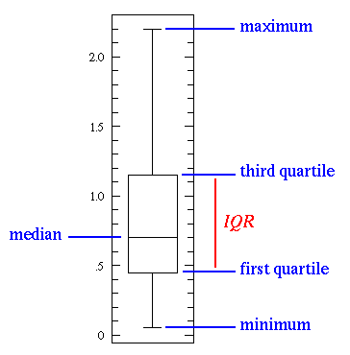
Box Plot

Slide 7
Descriptive Data Summarization
70
60
50
40
30
20
10
age

Slide 8
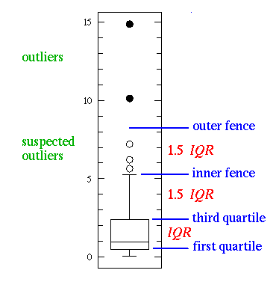
Box Plot (cont.)

Slide 9

Variance and Standard Deviation
The variance of N observations is:
Square root of the variance is called standard deviation.

Slide 10
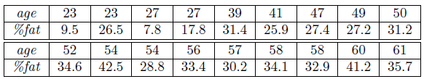
Variance and Standard Deviation
The variance of N observations is:
Square root of the variance is called standard deviation.
Ex.
Suppose a hospital tested the age and body fat data for 18 randomly selected adults with the following result.
Calculate the mean, median and standard deviation of age and %fat.

Slide 11
Variance and Standard Deviation
The variance of N observations is:
Square root of the variance is called standard deviation.
Ex.
Suppose a hospital tested the age and body fat data for 18 randomly selected adults with the following result.
Calculate the mean, median and standard deviation of age and %fat.
The mean is 46.44, the median is 51, and the standard deviation is 12.85. For the variable %fat the mean is 28.78, the median is (???), and the standard deviation is 8.99

Slide 12
Variance and Standard Deviation
The variance of N observations is:
Square root of the variance is called standard deviation.
Ex.
Suppose a hospital tested the age and body fat data for 18 randomly selected adults with the following result.
Calculate the mean, median and standard deviation of age and %fat.
The mean is 46.44, the median is 51, and the standard deviation is 12.85. For the variable %fat the mean is 28.78, the median is 30.7, and the standard deviation is 8.99

Slide 13
Boxplot
Draw the boxplots for age and %fat.

Slide 14
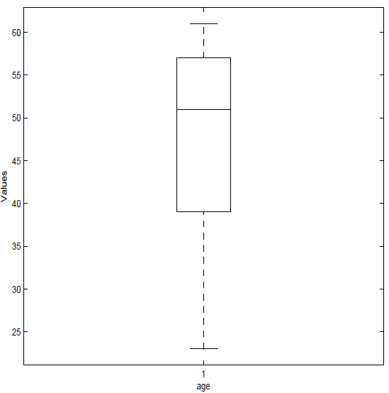
Boxplot
Draw the boxplots for age and %fat.

Slide 15
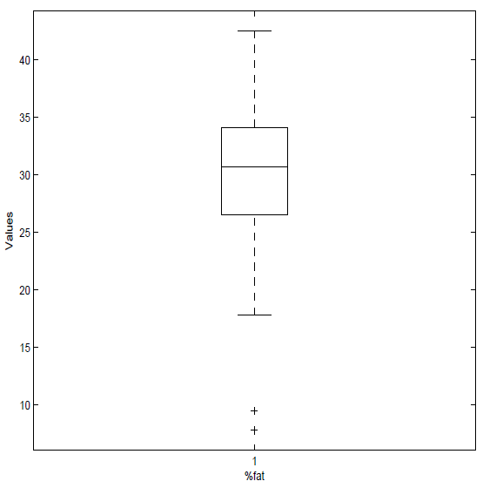
Boxplot
Draw the boxplots for age and %fat.

Slide 16
Scatter Plot
Draw a scatter plot based on these two variables.

Slide 17
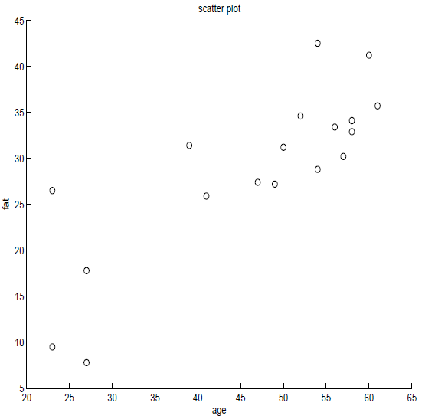
Scatter Plot
Draw a scatter plot based on these two variables.

Slide 18
Correlation
Calculate the correlation coefficient (Pearson's product moment coefficient). Are these two variables positively or negatively correlated?

Slide 19

Correlation
Calculate the correlation coefficient (Pearson's product moment coefficient). Are these two variables positively or negatively correlated?
The formula for Pearson's product moment coefficient is:

Slide 20
Correlation
Calculate the correlation coefficient (Pearson's product moment coefficient). Are these two variables positively or negatively correlated?
The formula for Pearson's product moment coefficient is:
0.82

Slide 21
Correlation
Calculate the correlation coefficient (Pearson's product moment coefficient). Are these two variables positively or negatively correlated?
The formula for Pearson's product moment coefficient is:
0.82; since it’s > 0, they are positively correlated
Scatter plot also showed same thing. Refer to earlier slide…

